Slide 1
Michelle 1103300142

Slide 2
About the Author Johanna Spyri
She was born on June 12,1827 and she died on July 7,1901. She was 73 years old.
“A Note on Vrony‘s Grave” was her first story. It was talking about a woman’s life with domestic violence.
She wrote more than fifty stories in her whole life.

Slide 3
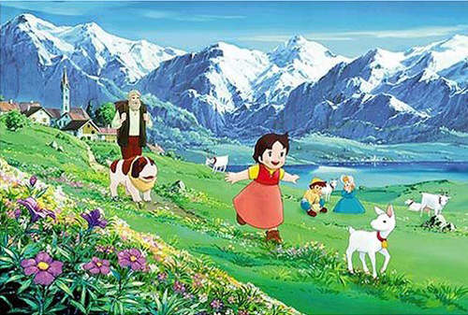
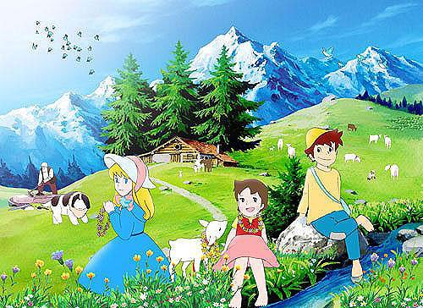
About the Characters
Heidi—She was an orphan, but she was optimistic.
Peter—He was a shepherd boy. He was Heidi’s best friend. He hated going to school, but he was filial.
Klara—Her family was rich, but her legs were paralyzed. In Heidi’s help, she overcame the problems with her legs and never felt lonely anymore.
Heidi’s grandfather—He seldom smiled, so everybody was afraid of him. But after Heidi came to live with him, he changed a lot.

Slide 4
About the Story
Heidi was an orphan. At first, she was brought up by her aunt who lived in Switzerland.
A few years later, Heidi had to live with her grandfather in the Alps. He didn’t like her very much at first. When Heidi lived with her grandfather, she met a friend who called Peter.
Afterward, Heidi’s aunt took her to Franklin to accompany Klara, the girl who had a problem with her leg.

Slide 5
About the Story
In the year Heidi lived in Franklin, she often came into conflict with the housekeeper. It caused her to get homesick. In order to escape her, Heidi read and wrote. One of the reason was that she hoped she could read some book for Peter’s grandmother who was blind.
However, Heidi still felt stressed. Finally, she got sick and even somnambulated(夢遊) at night, so the doctor wanted her to go back to live with her grandfather.

Slide 6
About the Story
When Heidi went back to the Alps, it was the first time that her grandfather went down the hill to greeted her. He also finished his lonely life. He began to get alone with people.
After Heidi went back to live with her grandfather, she kept communitcating by letter with Klara. She went to visit Heidi and stayed with her duing a summer vacation. Because of the fresh air and the goat milk, Klara became healthier and healthier. She tried to walk, and she succeeded finally. Klara’s father thought it was so unbelievable. To thank Heidi for accompanying Klara, he decided to arrange for Heidi’s future.

Slide 7
My Feelings About the Story
Interesting
Inspiring
Touching

