Slide 1
The Adventures of
Tom Sawyer
130 Julio

Slide 2
Author
Mark Twain
One of the famous and best-loved American authors . He was born in Samuel Clemens in Florida , Missouri in 1835 . He lived a rich and varied life working as a printer , riverboat pilot , gold prospector , journalist and lecturer .
He put his colorful experiences to good use in his stories , writing over 30 stories under the name Mark Twain.
He died in New York in 1910.

Slide 3
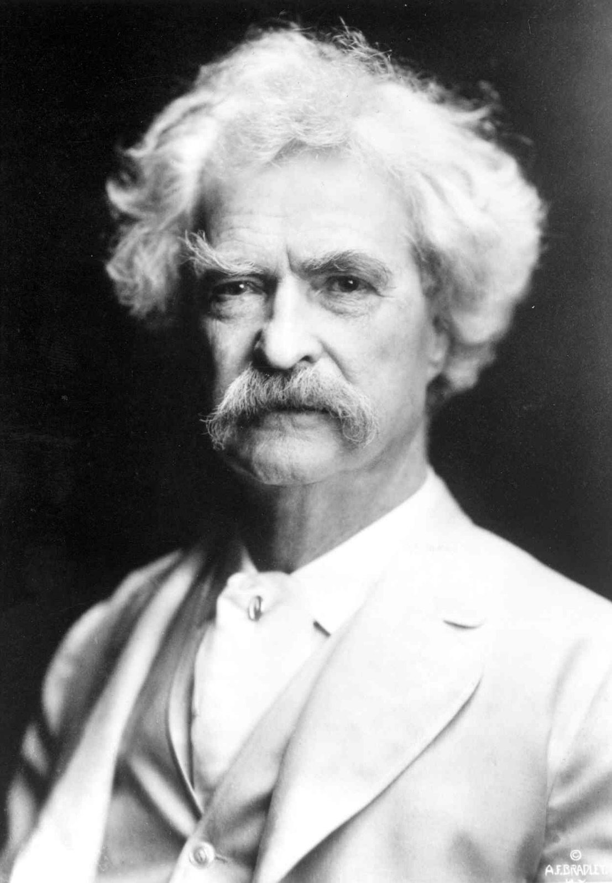
Mark
Twain

Slide 4
Main Character
Tom Sawyer - Naughty , good heart , become
responsible
Aunt Polly - Tom’s aunt . Kindhearted , simple
Huckleberry Finn - an outcast , a zest for adventure
Becky Thatcher – a pretty girl , fall in love with Tom

Slide 5
About the story
1.Tom is caught having gone swimming by Aunt Polly because
he used the wrong color thread to sew his shirt collar back on
2.Whitewashing the fence
3.Tom trades for the Sunday School Bible verse slips
4.Tom and Becky get engaged, then break up
5.Tom and Huck witness the stabbing of Dr. Robinson by Indian Joe
6.Tom & Huck swear a blood oath to each other never to reveal what
they have seen
7.Muff Potter is arrested for the murder of Dr. Robinson

Slide 6
8.Tom feels unloved and runs away with Huck and Joe to the island
9.The boys return to attend their own funeral
10.Tom takes Becky’s punishment for spilling ink across the schoolmaster’s
Book
11.Tom & Huck go searching for buried treasure & discover Injun Joe at the
abandoned house.
12.Huck discovers that Injun Joe plans to slit the Widow Douglas’s nostrils
13.Tom and Becky get lost in the cave
14.Indian Joe’s dead body is discovered weeks later in the sealed cave
15.Tom and Huck retrieve the treasure and are heroes

Slide 7
Reflection
Interesting
Horrifying
Touching

Slide 8
Thank you

