Slide 1
Anne of Green Gables
1103300164 許惠淳

Slide 2
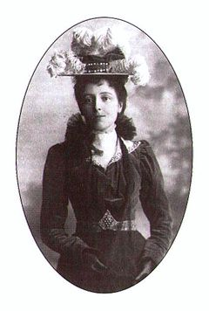
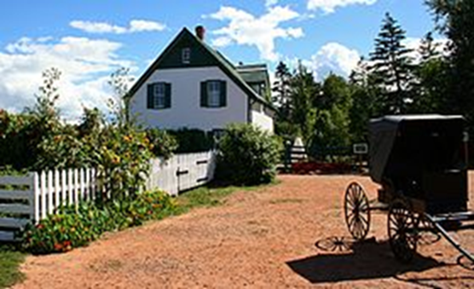
About author
Lucy Maud Montgomery
She is a writer from Canada.Her most famous work is
“Anne of Green Gables”.
Green Gables

Slide 3
Character
Anne Shirley—A red haired girl who had some freckles on the face.Was an orphan adopted by Matthews’.
Marilla Cuthbert—Matthew's sister,a serious woman.She wasn’t friendly to Anne this naughty girl first.But after Anne lived with her for few weeks,she found that Marilla is a tender person.
Matthew Cuthbert—Marilla's brother, a shy man.He picked Anne up at the train station.And on the way to home.Anne talked a lot about herself.He thought Anne is an interesting girl,and they became good friends soon.
Diana Barry—The girl who lived beside Anne.And they become best friends from the moment they met. She is the only girl of Anne's age who lives close to Green Gables.They were classmates in the school,too.
Gilbert Blythe—A handsome classmate who tried to get Anne's attention by pulling her hair and calling her "Carrots" Anne reacted by refusing to have anything to do with him for the next few years.But several years later,he helped Anne a lot once.They became closer.Finally,he married Anne.

Slide 4
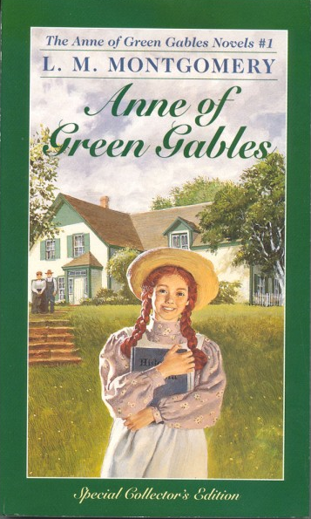
Matthew and his sister Marilla were living in Prince Edward Island. One day,they decided to adopt a boy to help farm working. But adoption center sent them a girl,called Anne. She was the kind of girl who was full of imagination and capable of expressing oneself. At first,Marilla planned to send Anne back. But Matthew thought that she can bring vitality into their life,so he decided to keep her. Now Anne’s new life began.
summary

Slide 5
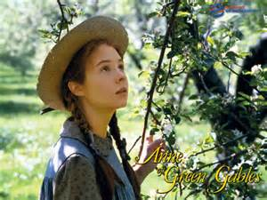
This story give me the impression that Anne was the kind of person, who was
positive and progressive though she was humble in her childhood, but she earned better life in the future.
No matter how hard the life will be we should live in happily,like Anne.

Slide 6
Thanks for your listening

