Slide 1
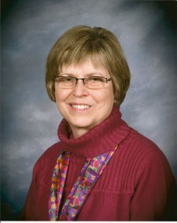
ON MY HONOR
Marion Dane Bauer

Slide 3
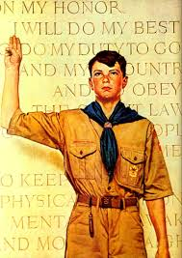
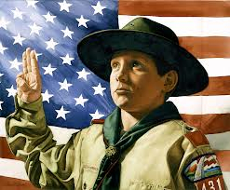

Slide 4
On My Honor
Main Idea

