Slide 1
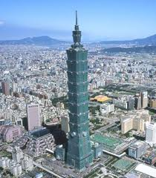
EU involvement in sustainable environment: Policy, implementation and cooperation opportunities for Taiwan
Vincent Rollet (羅文笙), PhD
2011 Jade Mountain Forum on Sustainable Environment
2011年玉山永續環境論壇
National Cheng-Kung University, Tainan, 21 April 2011

Slide 2
Plan
Development and principles of the EU environment policy
The EU 6th Environment Action Program (2000-2012): Priorities and implementation
Challenges of the EU environmental policy
EU’s involvement for sustainable development beyond Europe
Opportunities of cooperation between Taiwan and the EU in the domain of sustainable environment

Slide 3
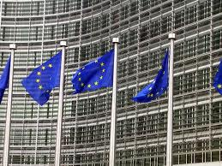
I. DEVELOPMENT AND PRINCIPLES OF THE EU ENVIRONMENT POLICY
a) Evolution of the EAPs
1st European Environment Action Program (EAP) (1973-1976).
2nd EAP (1977 - 1981)
3rd EAP (1982 – 1986)
4th EAP (1987 - 1992)
5th EAP (1992 - 1999)
6th EAP (2000-2012)
- Resolution of certain specific problems >> a more horizontal, preventive and integrated approach.
Synergies between business and environmental goals
- “Sustainable development” as a normative reference for environmental policy in the EU from the beginning of the 1990s onwards.

Slide 4
b. Principles
Principle of correction at source: Negative environmental effects should be prevented at the earliest possible stage.
Precautionary principle: It requires governmental action where scientific evaluation indicates that an industrial process or an industrial or consumer product is likely to have an irreversible impact on the environment, human health or plant health.
“Polluter pays” principle: At the heart of many EU laws dealing with standards for industrial products and emissions. It provides a direct incentive for potential polluters not to pollute. Ex: 2004 Directive on Environmental Liability
Principle of access to Information, Public Participation in Decision-making and Access to Justice in Environmental Matters.

Slide 5
II. THE EU 6th ENVIRONMENTAL ACTION PROGRAM (2000-2012)
A) 5 main avenues for strategic action
Improving the implementation of existing legislation
Integrating environmental concerns into other policies
Working in partnership with business
Empowering citizens and changing their behaviour
Taking account of the environment in land-use planning and management.

Slide 6
B) 4 priority areas
Climate change
Nature and biodiversity
Environment, health and quality of life
Waste management

Slide 7
Addressing climate change issue

Slide 8
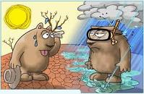
European Union's aim is to reduce greenhouse gas emissions by 8% by 2008-2012 compared with 1990 levels
The EU efforts to meet the challenges of climate change are:
The integration of climate change objectives into various Community policies, in particular energy policy and transport policy
Improved research on climate change
The improvement of the information provided to citizens on climate change
Preparing society for the impact of climate change

Slide 9
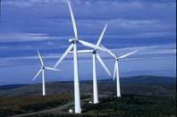
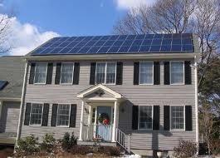
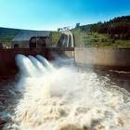
The reduction of greenhouse gases by means of specific measures to improve energy efficiency, to make increased use of renewable energy sources and to make energy savings
+ April 2009: New Renewable Energies Directive
Each member state has to increase its share of renewable energies – such as solar, wind or hydro –to raise the overall share from 8.5% today to 20% by 2020.
Member State | Share of renewables in 2005 | Share required by 2020
Austria | 23.3% | 34%
Belgium | 2.2% | 13%
Czech Republic | 6.1% | 13%
France | 10.3% | 23%
Germany | 5.8% | 18%
Hungary | 4.3% | 13%
Malta | 0% | 10%
Sweden | 39.8% | 49%

Slide 10
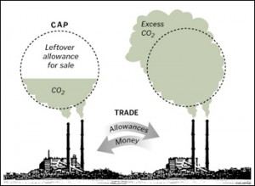
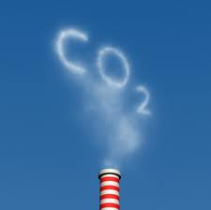
Establishment of an EU-wide emissions trading scheme (ETS) since 2005.
+ EU ETS works on the "cap and trade" principle
+ Today, the EU ETS covers some 11,000 power stations and industrial plants in 30 countries (the 27 EU Member States plus Iceland, Liechtenstein and Norway).
+ Airlines will join the scheme in 2012. The EU ETS will be further expanded to the petrochemicals, ammonia and aluminium industries and to additional gases in 2013.

Slide 11
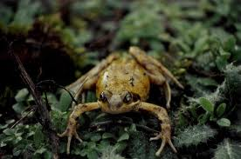
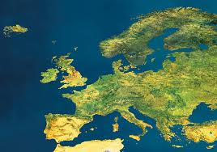
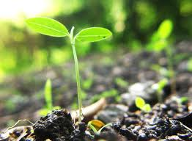
Protecting Europe’s fragile nature and biodiversity

Slide 12
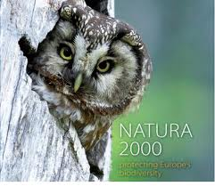
3 thematic areas: Biodiversity, Air quality & Clean water
Biodiversity
The EU is committed to the protection of biodiversity and to halting biodiversity loss within the EU by 2020
Natura 2000: Network of 26.000 protected areas in all the Member States and an area of more than 750.000 km2, which is 18% of the EU’s land area

Slide 13
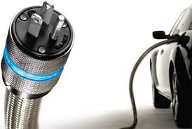
Air quality
Still a major concern for many European citizens
“Urban air pollution, especially particulate matter, causes significant health problems throughout the region, reducing the life expectancy of residents of more polluted areas by over one year”. (WHO)
Immediate measures (in 2011) are, e.g.:
+ Revision of the sulphur content of bunker fuels
+ Review and further reducing emissions from vehicles and machinery: Sustainable Urban Mobility Plans

Slide 14
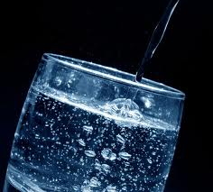
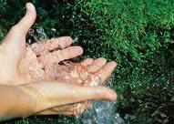
Clean Water
2000: Water Framework Directive (WFD)
A new legislative approach to managing and protecting water, based not on national or political boundaries but on natural geographical and hydrological formations: river basins
Measures under the WFD:
+ to prevent and reduce the pollution of water resources,
+ to promote sustainable water use,
+ to improve the condition of water,
+ to mitigate the effects of floods and droughts in the territory of the European Union.
Ex: Measures to fight water scarcity

Slide 15
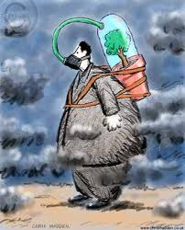
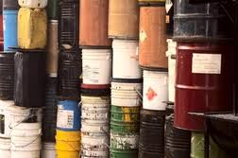
Environment, health and quality of life

Slide 16
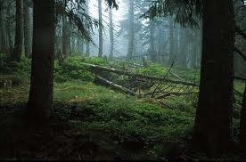
To achieve a quality of the environment which does not give rise to significant impacts on, or risks to, human health
Measures:
Identifying the risks to human health, including that of children and the elderly, and setting standards accordingly;
Introducing environment and health priorities into other policies and standards on water, air, waste and soil;
Intensifying research on health and the environment;
Banning or limiting the use of the most hazardous pesticides and ensuring that best practice is applied
Developing a new system for the evaluation and the risk management of chemicals;

Slide 17
Ex: REACH :Registration, Evaluation, Authorization and Restriction of Chemical substances (2007)
- Places greater responsibility on industry to manage the risks from chemicals and to provide safety information on the substances.
- Manufacturers and importers are required to gather information on the properties of their chemical substances, which will allow their safe handling, and to register the information in a central database run by the European Chemicals Agency (ECHA) in Helsinki

Slide 18
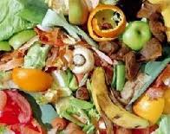
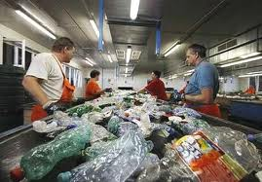
Waste Management

Slide 19
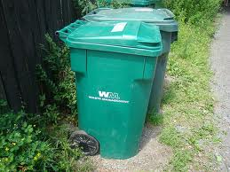
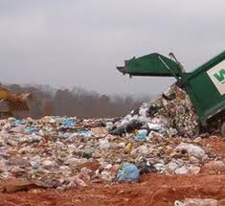
Each year in the European Union alone we throw away 3 billion tonnes of waste - some 90 million tonnes of it hazardous
The EU is aiming for a significant cut in the amount of rubbish generated, through :
New waste prevention initiatives,
Better use of resources
Encouraging a shift to more sustainable consumption patterns.

Slide 20
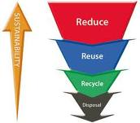
The European Union's approach to waste management is based on three principles:
Waste prevention
Recycling and reuse
Improving final disposal and monitoring

Slide 21
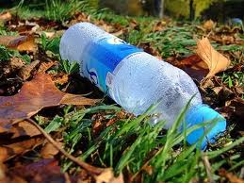
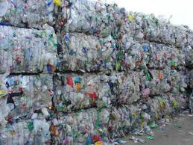
III> CHALLENGES OF THE EU ENVIRONMENTAL POLICY
Member States included many green initiatives in their economic recovery plans, seeking to move towards a low-carbon and resource-efficient economy
Although progress is evident in some environmental areas, further efforts are needed in many others.

Slide 22
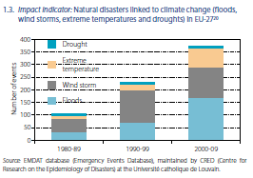
Climate change
Increasing number of natural disasters linked to climate change (floods, wind storms, extreme temperatures and droughts) in EU-27

Slide 23
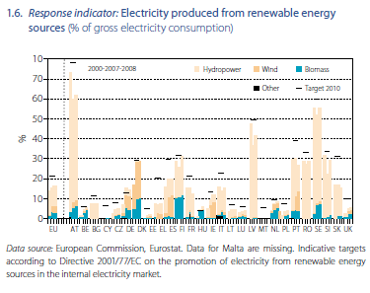
A level of Electricity produced from renewable energy sources (in terms of % of gross electricity consumption) still far from EU target
(Note: EE: Estonia, EL: Greece)

Slide 24
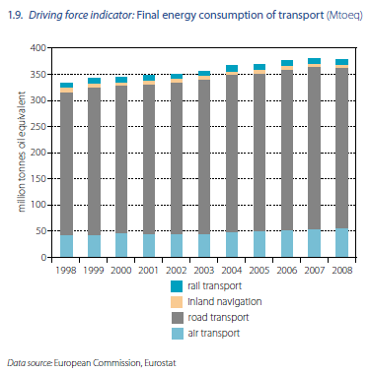
An increase in terms of final energy consumption of transport

Slide 25
Nature and biodiversity
The EU biodiversity picture remains mixed, with positive developments for some species and habitats overshadowed by worrying trends elsewhere
Grasslands, wetlands and coastal habitats are the most vulnerable
Protection of soil biodiversity continues to present a challenge

Slide 26
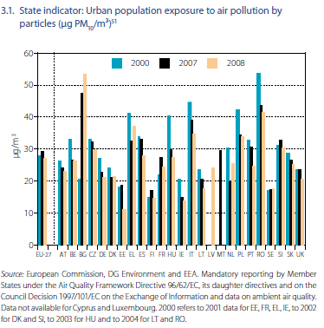
Health and environment
Urban population exposed to air pollution by particles still very high.

Slide 27
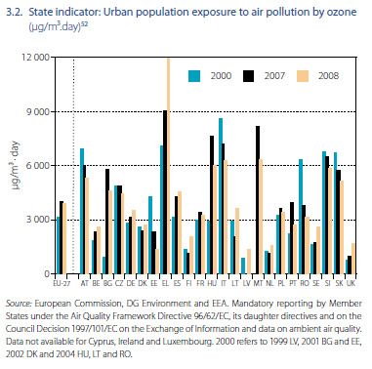
Urban population exposed to air pollution by ozone still high

Slide 28
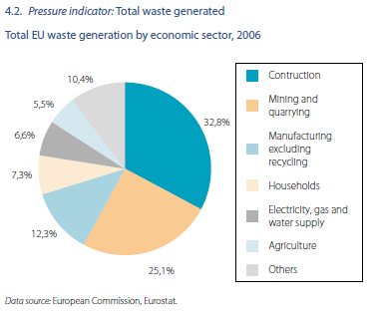
Waste Management
An increase of total waste generated

Slide 29
IV> EU’s involvement for sustainable development beyond Europe
High-level bilateral dialogues on environment (Australia, Brazil, Canada, China, India, Japan, Russia and the United States.)
Regional and sub-regional dialogue: ASEM & EU-ASEAN
Dialogue and cooperation on environment and sustainable development in the context of multilateral processes: OECD, G8
promotes environmental protection and the safeguarding of natural resources worldwide
Global and regional programmes: Environment and Tropical Forests Programme & Asia Pro Eco programme

Slide 30
V> Opportunities of cooperation between Taiwan and the EU in the domain of sustainable environment
A. Research and academic cooperation
1) With the European Commission
> 7th EU Framework Program for Research an Technological Development (FP7) : 864 billions of euros to Environment-related research between 2007 and 2013

Slide 31
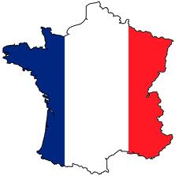
2) With EU Member States
FRANCE
# 3 main frameworks to support Taiwan-France research in Environment
1. NSC/ANR “Blanc International” Programme
- A collaboration agreement was signed between the French National Agency for Research (ANR) and the National Science Council of Taiwan (NSC) in order to facilitate the setting-up and implementation of scientific projects of quality jointly proposed by French and Taiwanese research teams
- All fields of Science and Technology are eligible
- Priority will be given to projects falling within the scope of the following areas:
Social Science and Humanities
Environment
Energy
Information and Communication Science and Technologies
Nanoscience and Nanotechnologies
Biology-Health-Biotechnologies-Technologies for Health

Slide 32
Planned schedule:
- Closing of the ANR call for proposals: April 14th, 2011
- Joint ANR/NSC decision and publication of the results: November 2011
- Possible start of projects: December 2011-January 2012
Further information: http://www.fi-taipei.org/
2. ORCHID Program
Initiated by the NSC, the French MOFA and the French Institute in Taipei.
Through two calls for proposal every year, it offers the opportunity to support common research projects and scientific workshop initiated by French-Taiwanese research teams.
All fields of Science and Technology are eligible.
Schedule:
Closing of the ORCHID call for proposals: May 20th, 2011
Joint ORCHID/NSC decision and publication of the results: December 2011
Possible start of projects: January 2012
Further information: http://www.fi-taipei.org/

Slide 33
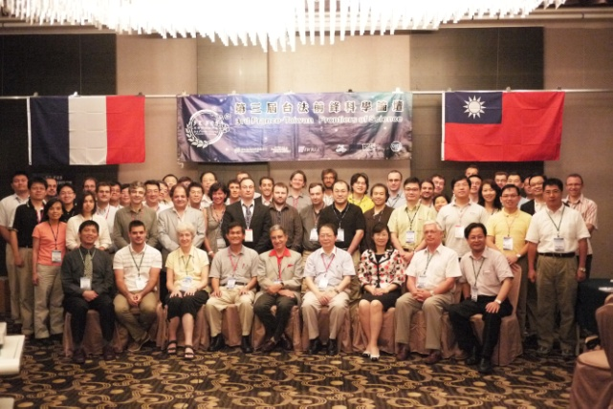
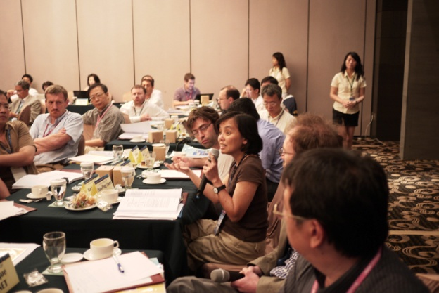
3. « Frontiers of Science » Program
Since 2007, the French MOFA, the Ministry of Higher Education and Research and the main French scientific institutions organize prestigious symposia with Taiwan.
Destined to gather promising and talented French young researchers to have cross-disciplinary interactions with fellow scientists of Taiwan.
Starting point of innovative and sustainable cooperations between French and Taiwanese research teams
Further information: http://www.sciencefrontiers.fr/?lang=en
And
http://www.ora.nsysu.edu.tw/FT-FoS/FTFoS2010.htm

Slide 34
# French research institutions in the domain of sustainable environment
Institutions | Domains of research and expertise
CIRAD: Agricultural Research for Development Institute http://www.cirad.fr/en | - Biomass and Energy - International Research on Environment and Development (UMR CIRED) - Conservation, Agriculture and Engineering - Envionmental Risks of Recycling - Management of Renewable Resources and Environment - Water Resource Management - Water, Soil and Plant Analysis
IRD : Research Institute for Development http://en.ird.fr/the-ird | Hydrology and environment Population-Environment-Development Biotechnology and environment Water management Sea ecosystems Governance, environment and risks
INRA : National Institute on Agricultural Research http://www.inra.fr/ | - Environment & health - Forest and sea ecology ...
IFREMER : French Institute on Sea Research http://wwz.ifremer.fr/institut_eng | - Sea, pollution and envionment - Water quality analysis - Sea biodiversity protection
CEMAGREF : Research Institute on Environmental Science and Technology http ://www.cemagref.fr | Water management and pollution Technological innovatio for sustainable environment Waste management Air quality

Slide 35
GERMANY
- « Sustainability Project », German Institue in Taipei
Objective: To connect German-Taiwanese partnerships in science, economy and culture with the debate on sustainability in Taiwan.
Further information : http://www.taipei.diplo.de/Vertretung/taipei/en/Startseite.html

Slide 36
Some useful tools to build partnerships:
To contact the concerned researchers directly
To send doctorate or post-doctorate students to targeted research institutions
To invite European researchers to conferences held in Taiwan
To participate to international events on sustainable environment in Europe.
Networking events, EU Info days,…
International Conferences in Europe,…
* May 24, 2011: Europe Renewable Energy Conference, Brussels
* May 24-27, 2011: EU Green WEEK, biggest annual conference on European environment policy. (http://ec.europa.eu/environment/greenweek/ )
*May 31, 2011: EU Sustainable Chemicals Management Conference 2011, Brussels
….

Slide 37
B. Networking, international visibility, advocacy, etc..
1/ Asia Europe Environment Forum (ENVforum) http://www.asef.org/index.php?option=com_programme&task=view&id=17&Itemid=162
2/ Advocacy cooperation with European NGOs involved in the EU Environmental policy-making: Ex: Green 10
3/ OECD/ Global Forum on Environment (GFENV)
http://www.oecd.org/document/51/0,3746,en_2649_33713_42110515_1_1_1_1,00.html
Etc…

Slide 38
Thank you for your attention!
Thank You
Merci! 謝謝!
¡Gracias!
Danke schön!
Grazie!
Obrigad@!
σαςευχαριστώ !

